Slide 1
InsertionSort (array Arr): for i in range(1, len(Arr)): current_element = Arr[i] j = i - 1 # Move elements of arr[0..i-1], that are greater than current_element, # one position ahead of their current position while j >= 0 and current_element < Arr[j]: Arr[j + 1] = Arr[j] j = j-1 Arr[j + 1] = current_element

Slide 2
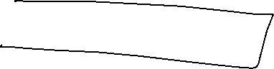
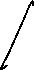
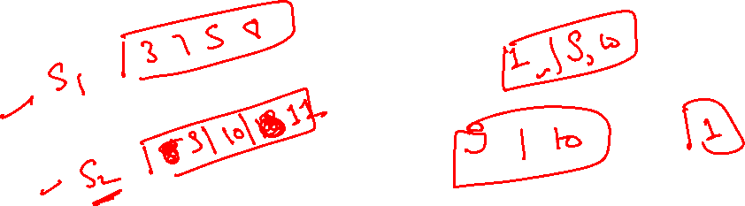
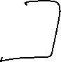
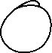
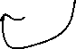
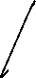
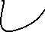

Slide 3
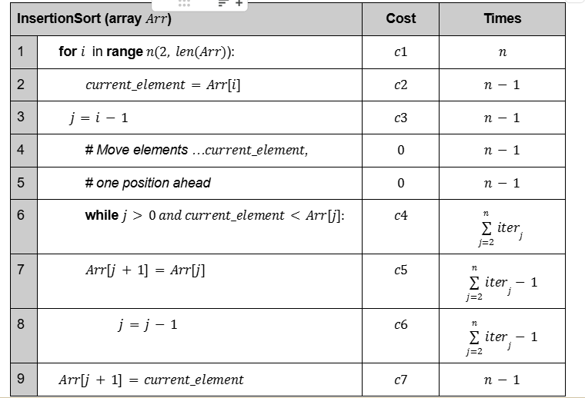
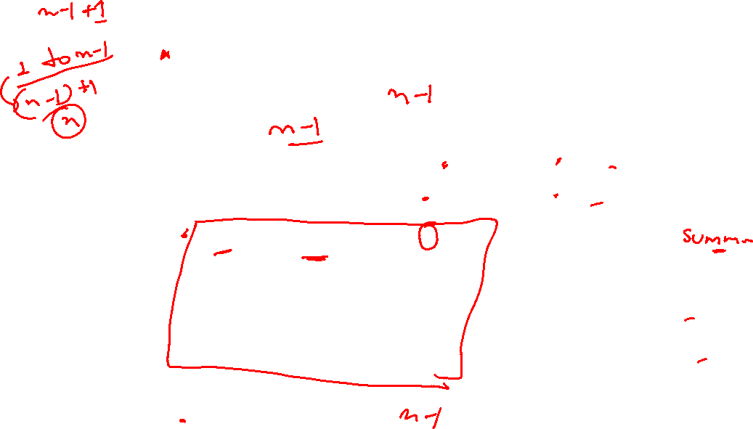
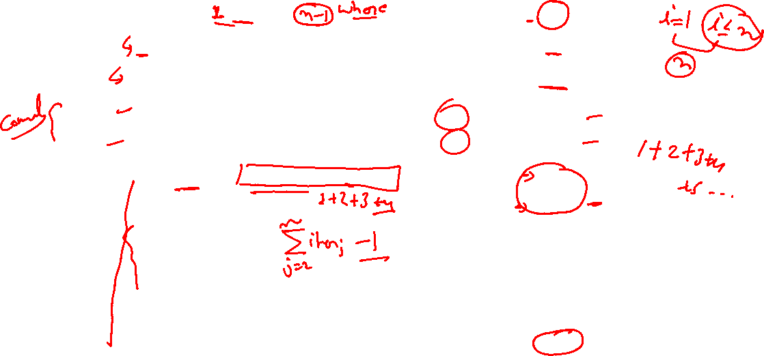

Slide 4

1+2+3+4… n(n+1)/2
= summation
(n-1)(n-1+1)/2 = n(n-1)/2

Slide 5
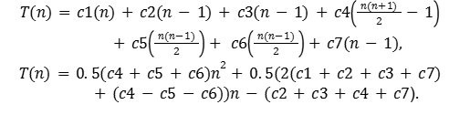
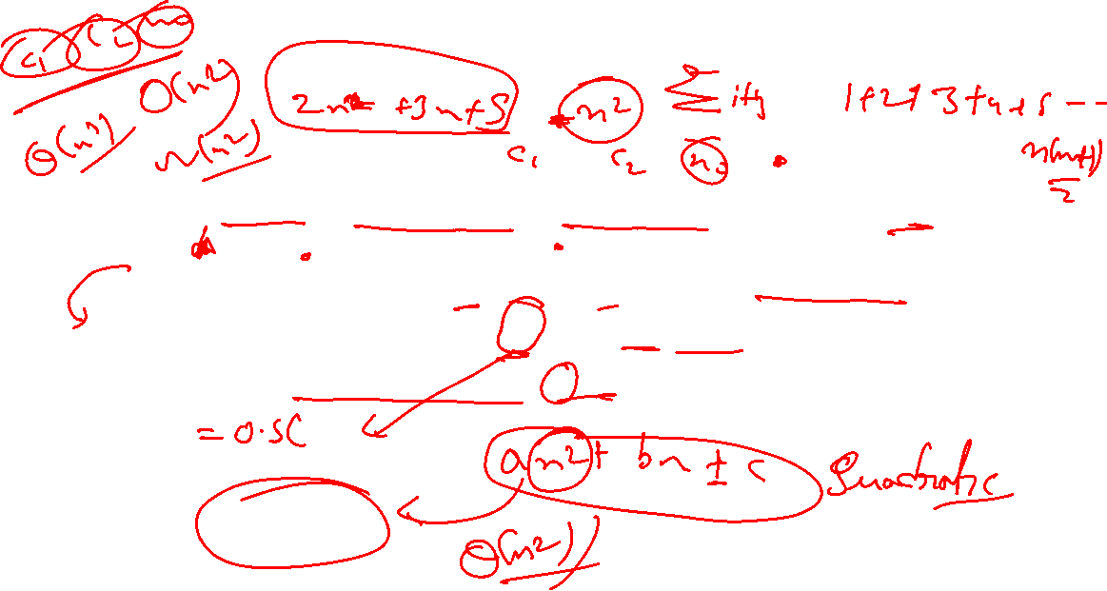
Theta(n^2)

Slide 6
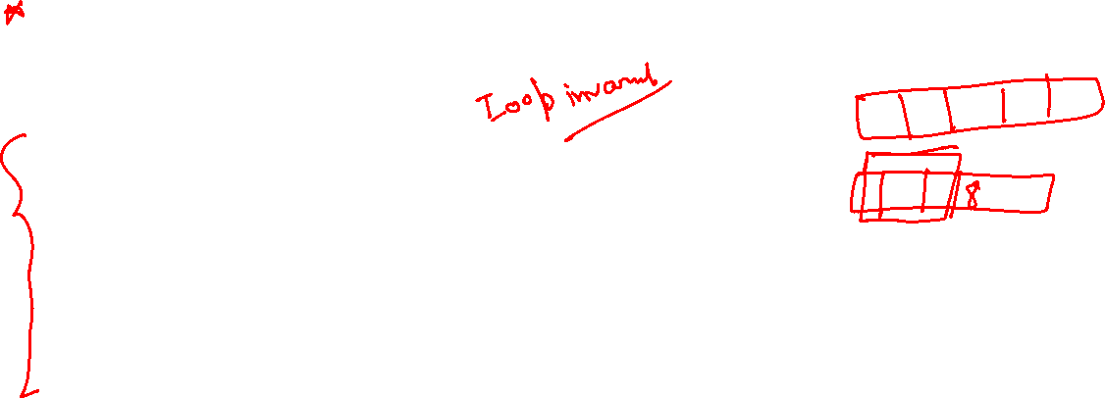
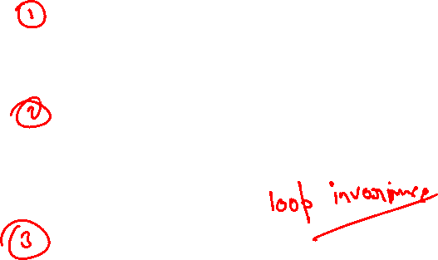
The employment of loop invariants aids in comprehending the validity of an algorithm. It necessitates demonstrating three key conditions of loop invariant:
Condition 1 (Initialization):
This condition holds before the initial iteration of the loop.
Condition 2 (Maintenance):
If the condition is true before a loop iteration, it will persist before the subsequent iteration.
Condition 3 (Termination):
Upon the conclusion of the for loop, such invariant furnishes an important feature that aids in demonstrating the correctness of the algorithm.

Slide 7
Now we have seen how the insertion sort operates, let us look at how these characteristics relate to the insertion sort algorithm. Let us utilize the example array Arr[2,4,3,6,8,9] to apply the loop invariant to the Insertion sort algorithm.
Condition 1: We initiate insertion sort by demonstrating the validity of the loop invariant at onset of initial iteration, where i=2. In this case, the subarray Arr[1:i-1] comprises only the element Arr[1], which is essentially the original element in Arr[1]. Furthermore, it is evident that this subarray is inherently sorted, affirming the preservation of loop invariant preceding initial iteration.

Slide 8
Condition 2: Next, we address 2nd condition, where iterations loop invariant should be maintained. In simpler terms, the operations of the for loop involves shifting elements, and so forth, one position to the right, until it identifies the correct position for Arr[i]. Subsequently, it inserts the value of Arr[i] at that position. The subarray now contains elements Arr[1:i-1], following sorted order. The increment of i subsequent iteration of the loop ensures preservation of the loop invariant.
Condition 3: Lastly, let us analyze what occurs upon the termination of the loop. The condition that leads to the termination of the for loop is that j>A:length equals n. Since each iteration increments j by 1, it follows that j=n+1 when the loop terminates. By substituting n+1 for j in the context of the loop invariant, we affirm that the subarray Arr[1:n] comprises the elements originally in Arr[1:n], now arranged in a sorted order.

Slide 9
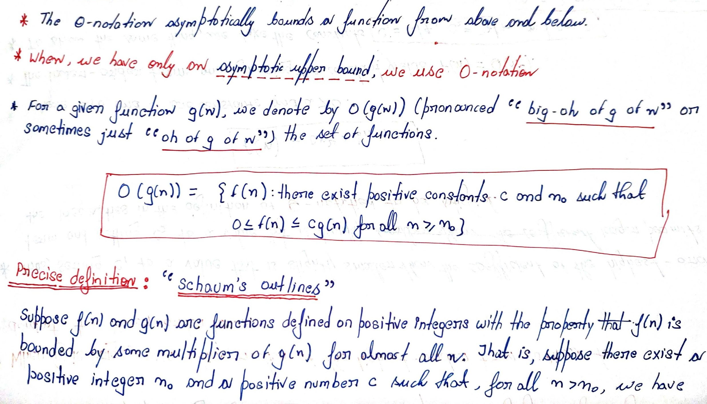
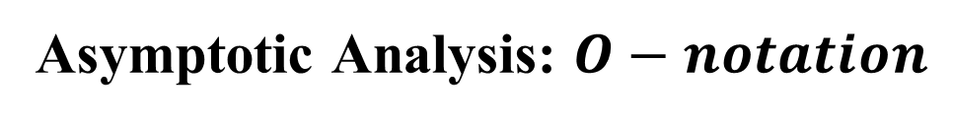
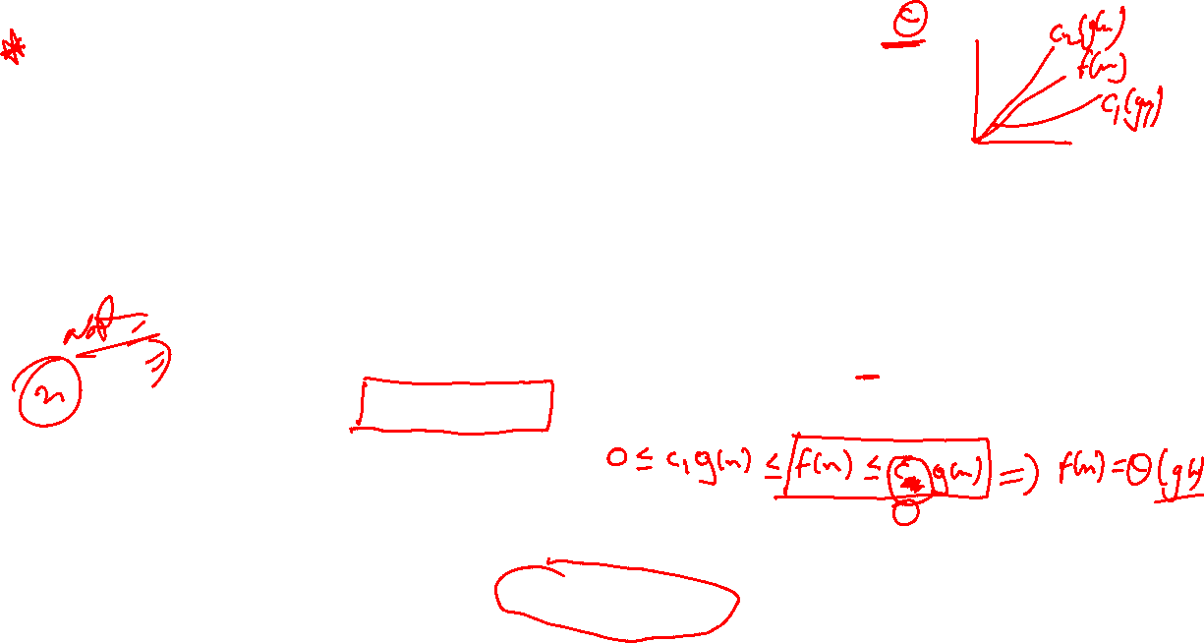

Slide 10
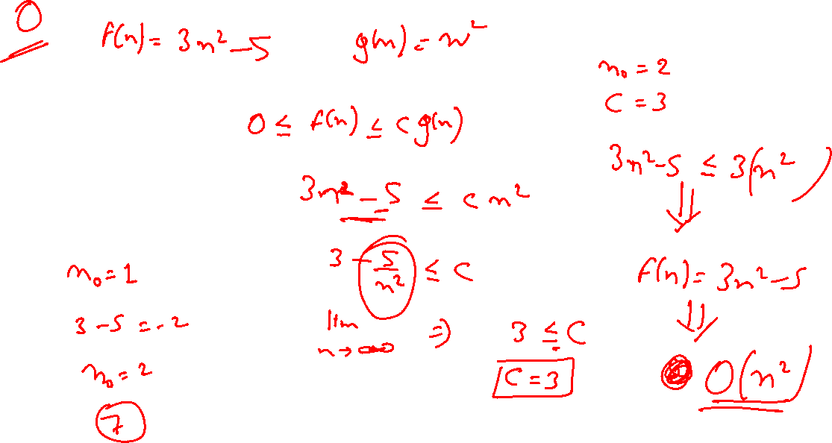

Slide 11
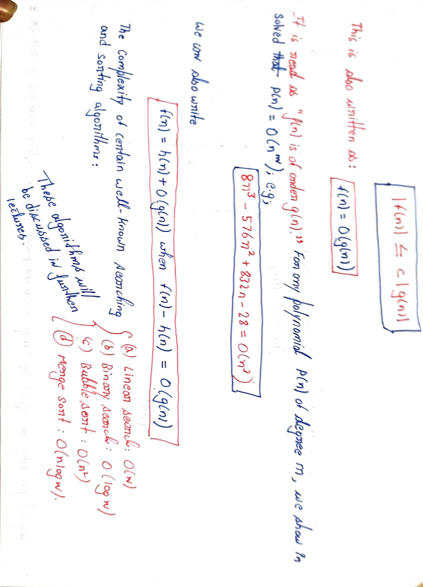
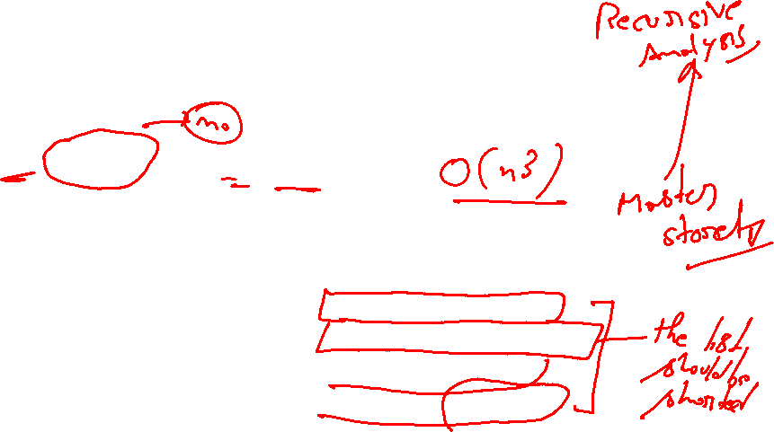

Slide 12
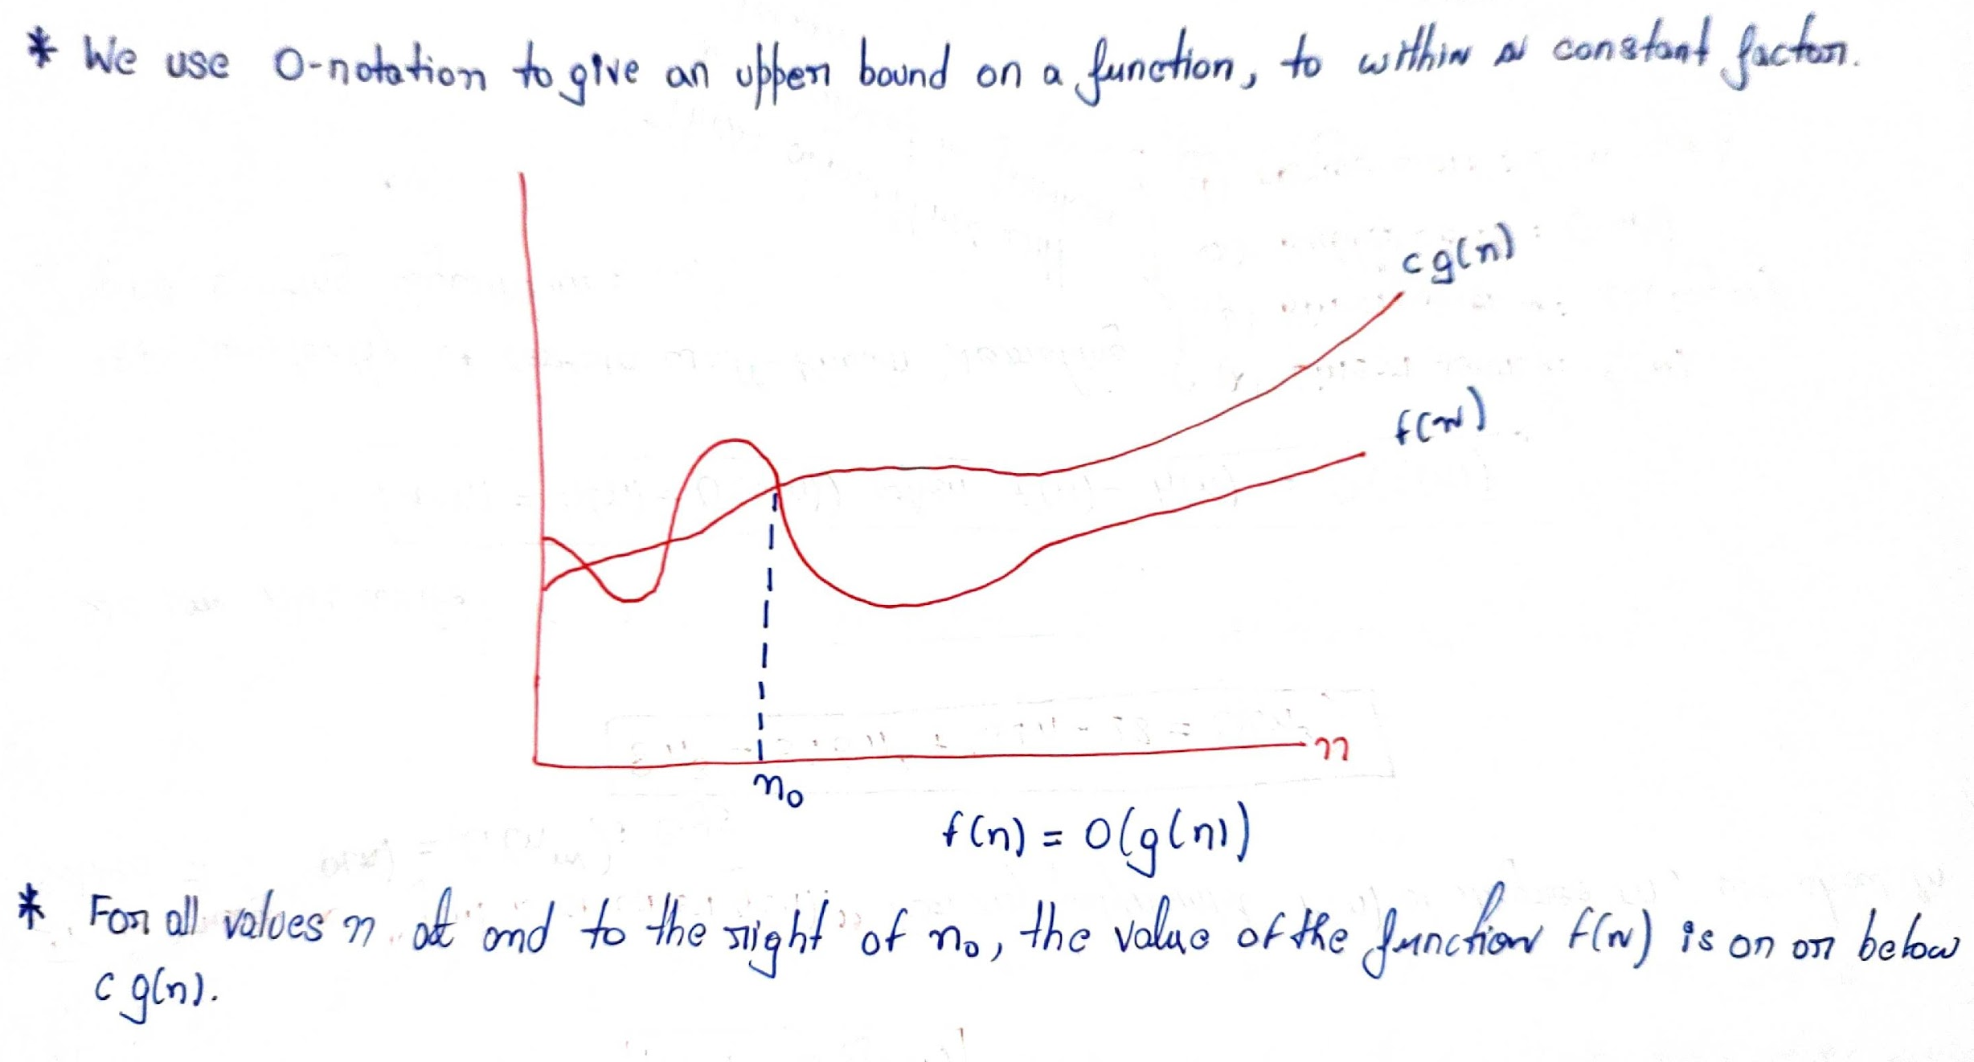
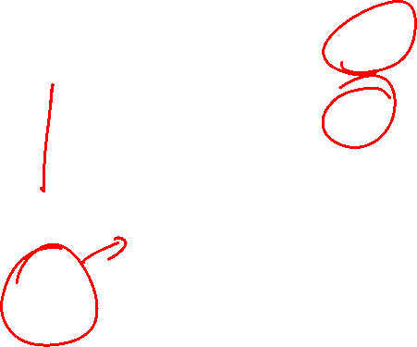

Slide 13
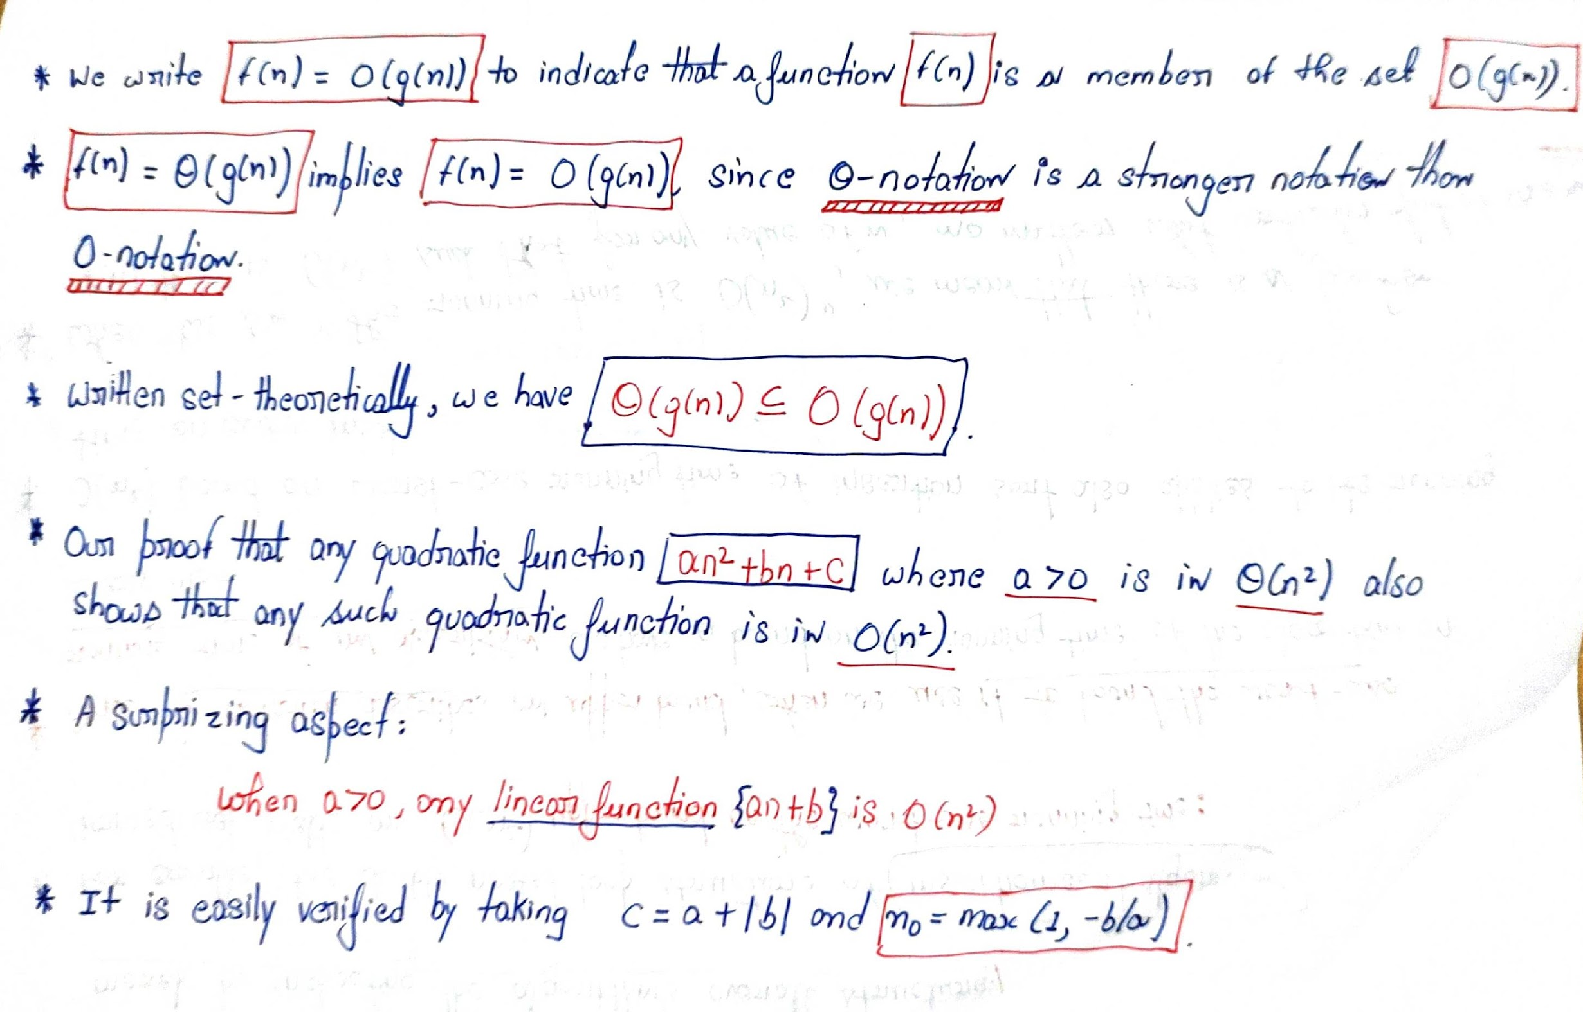
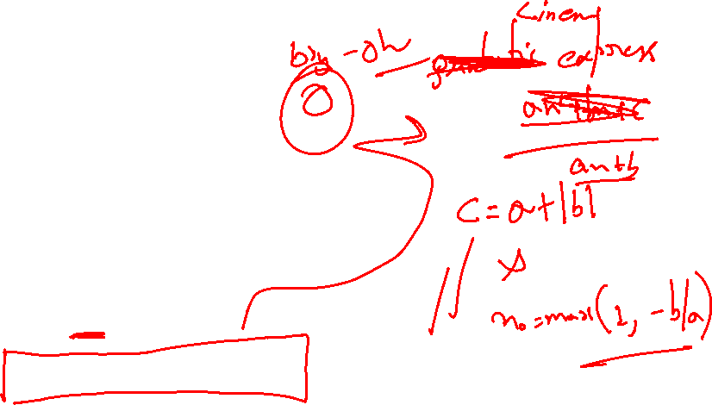

Slide 14
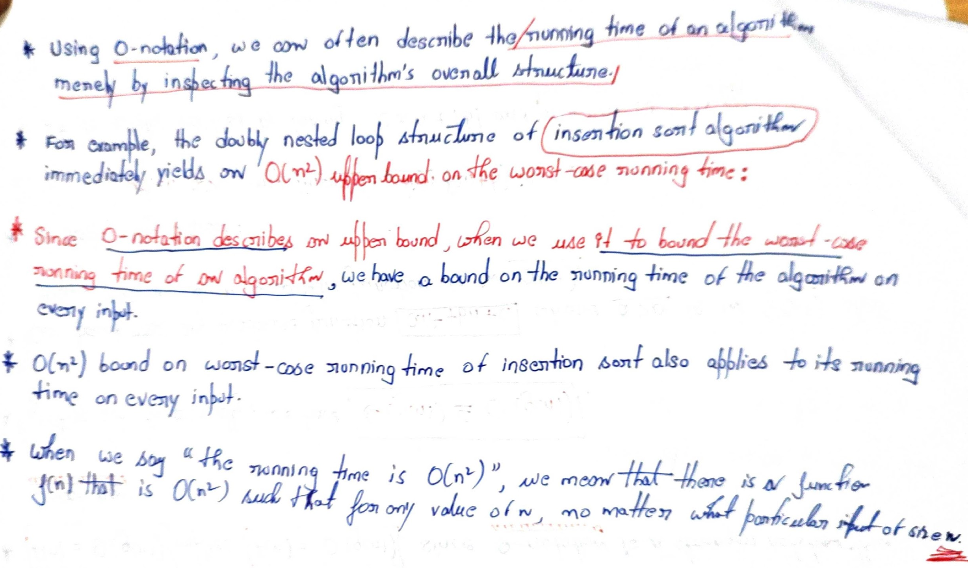
Size n

Slide 15
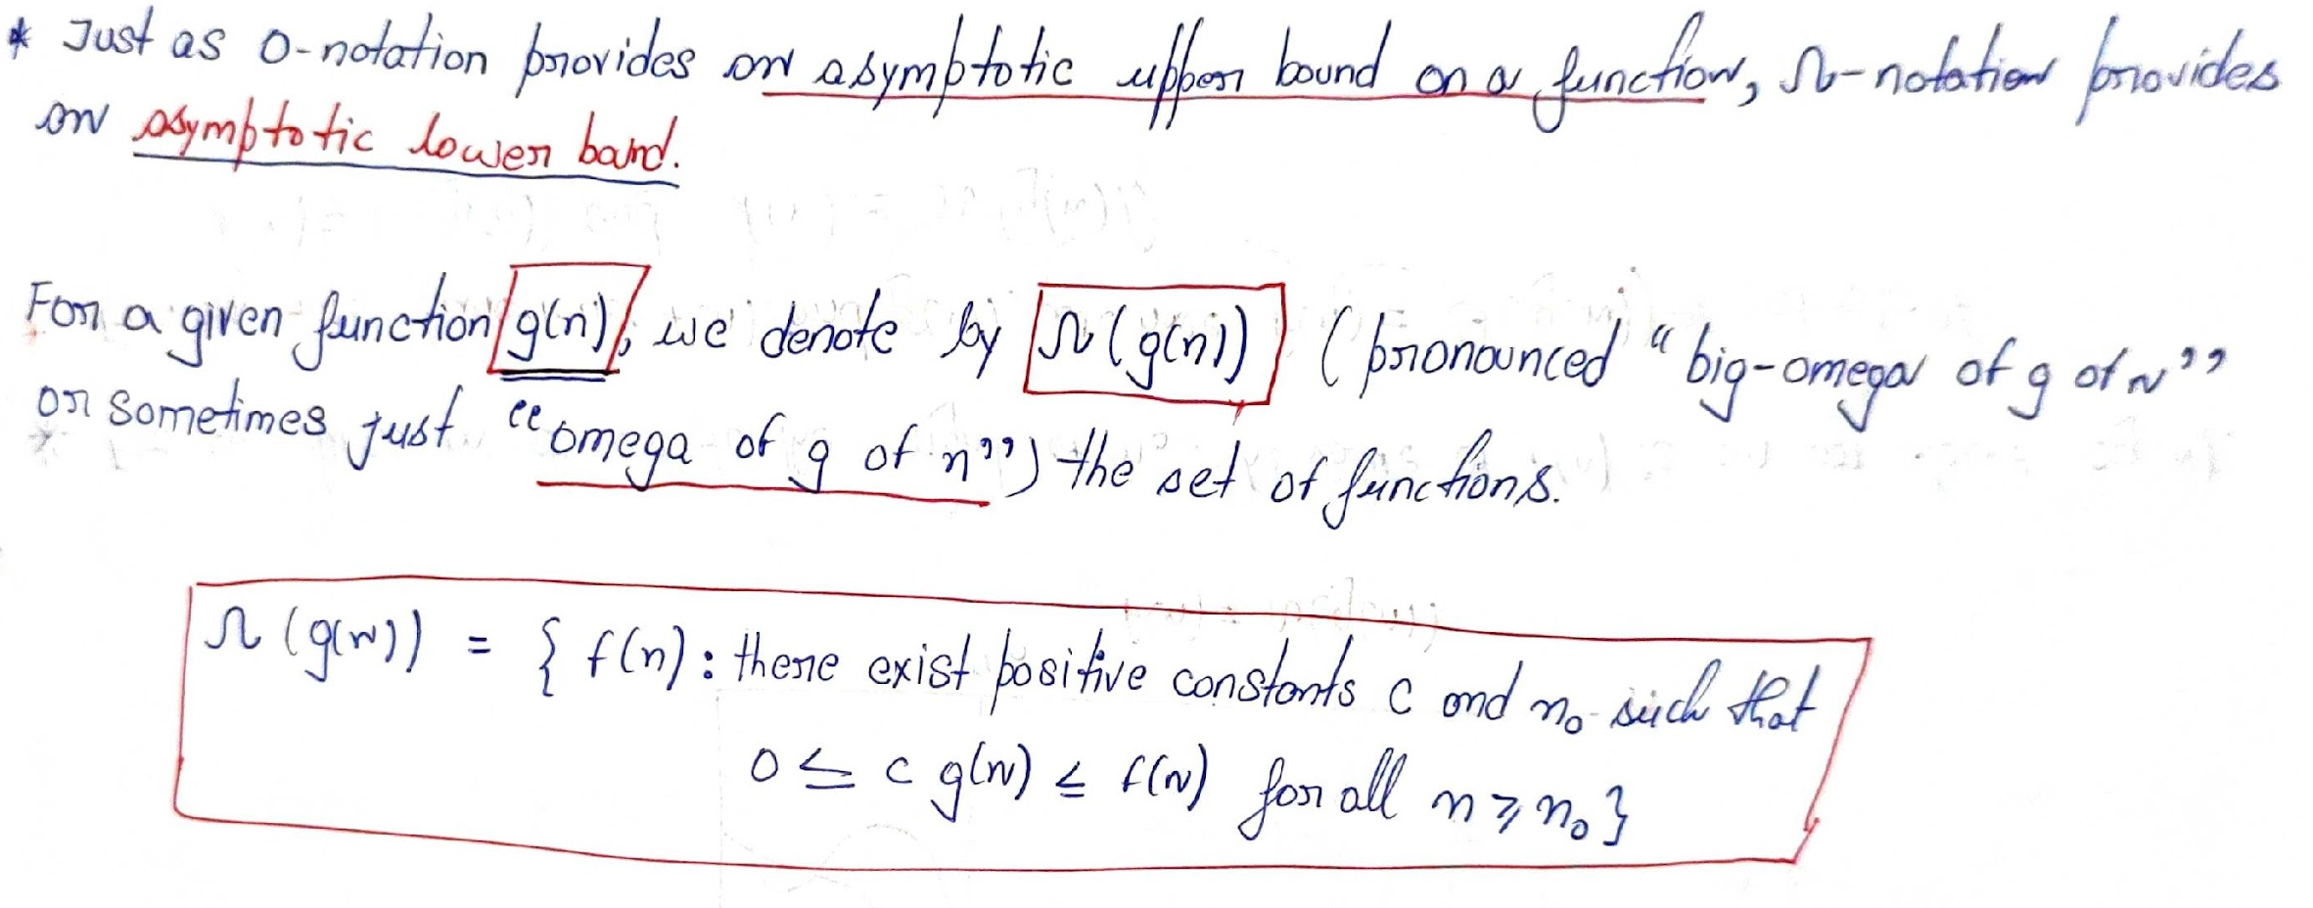
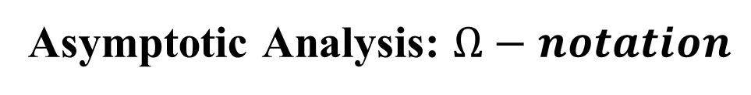
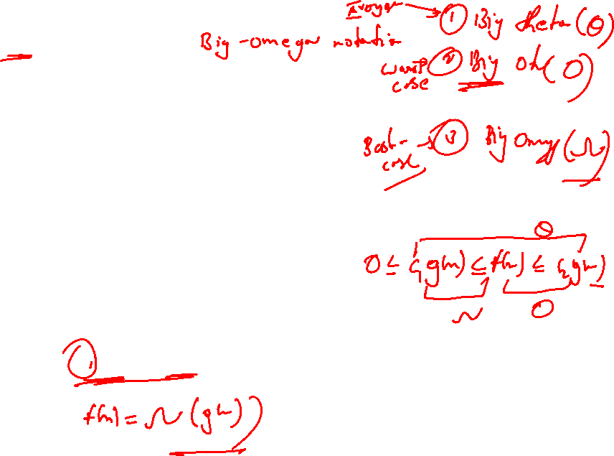

Slide 16
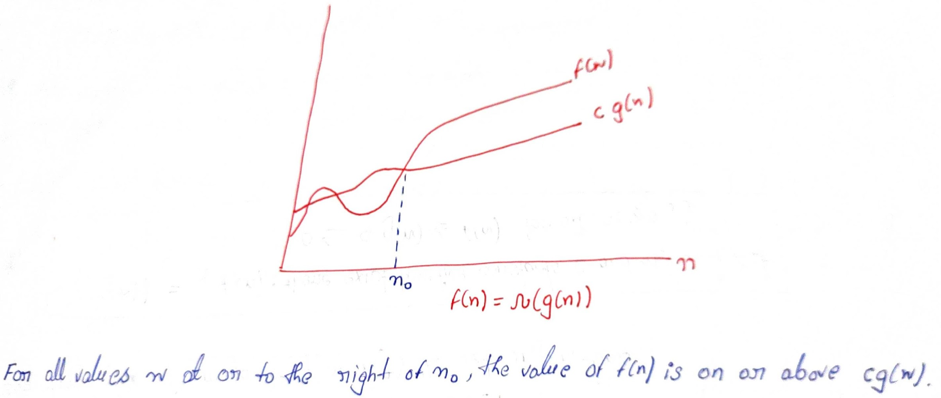
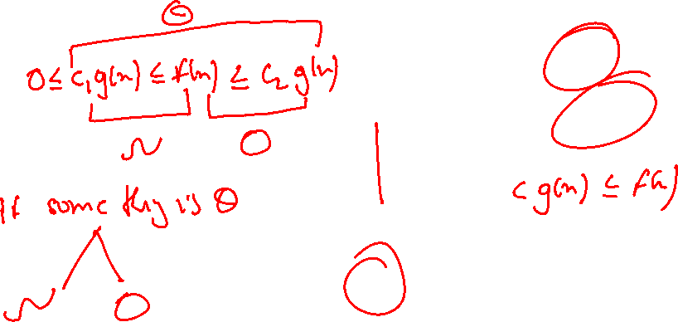

Slide 17
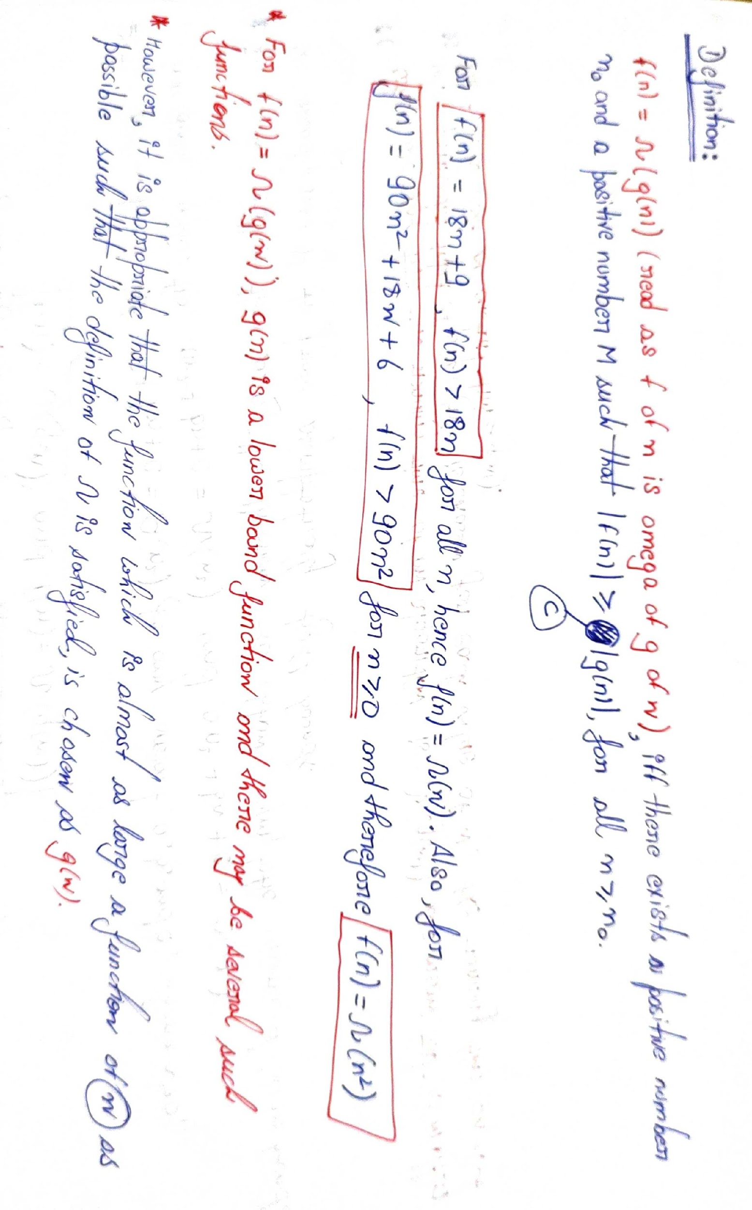

Slide 18
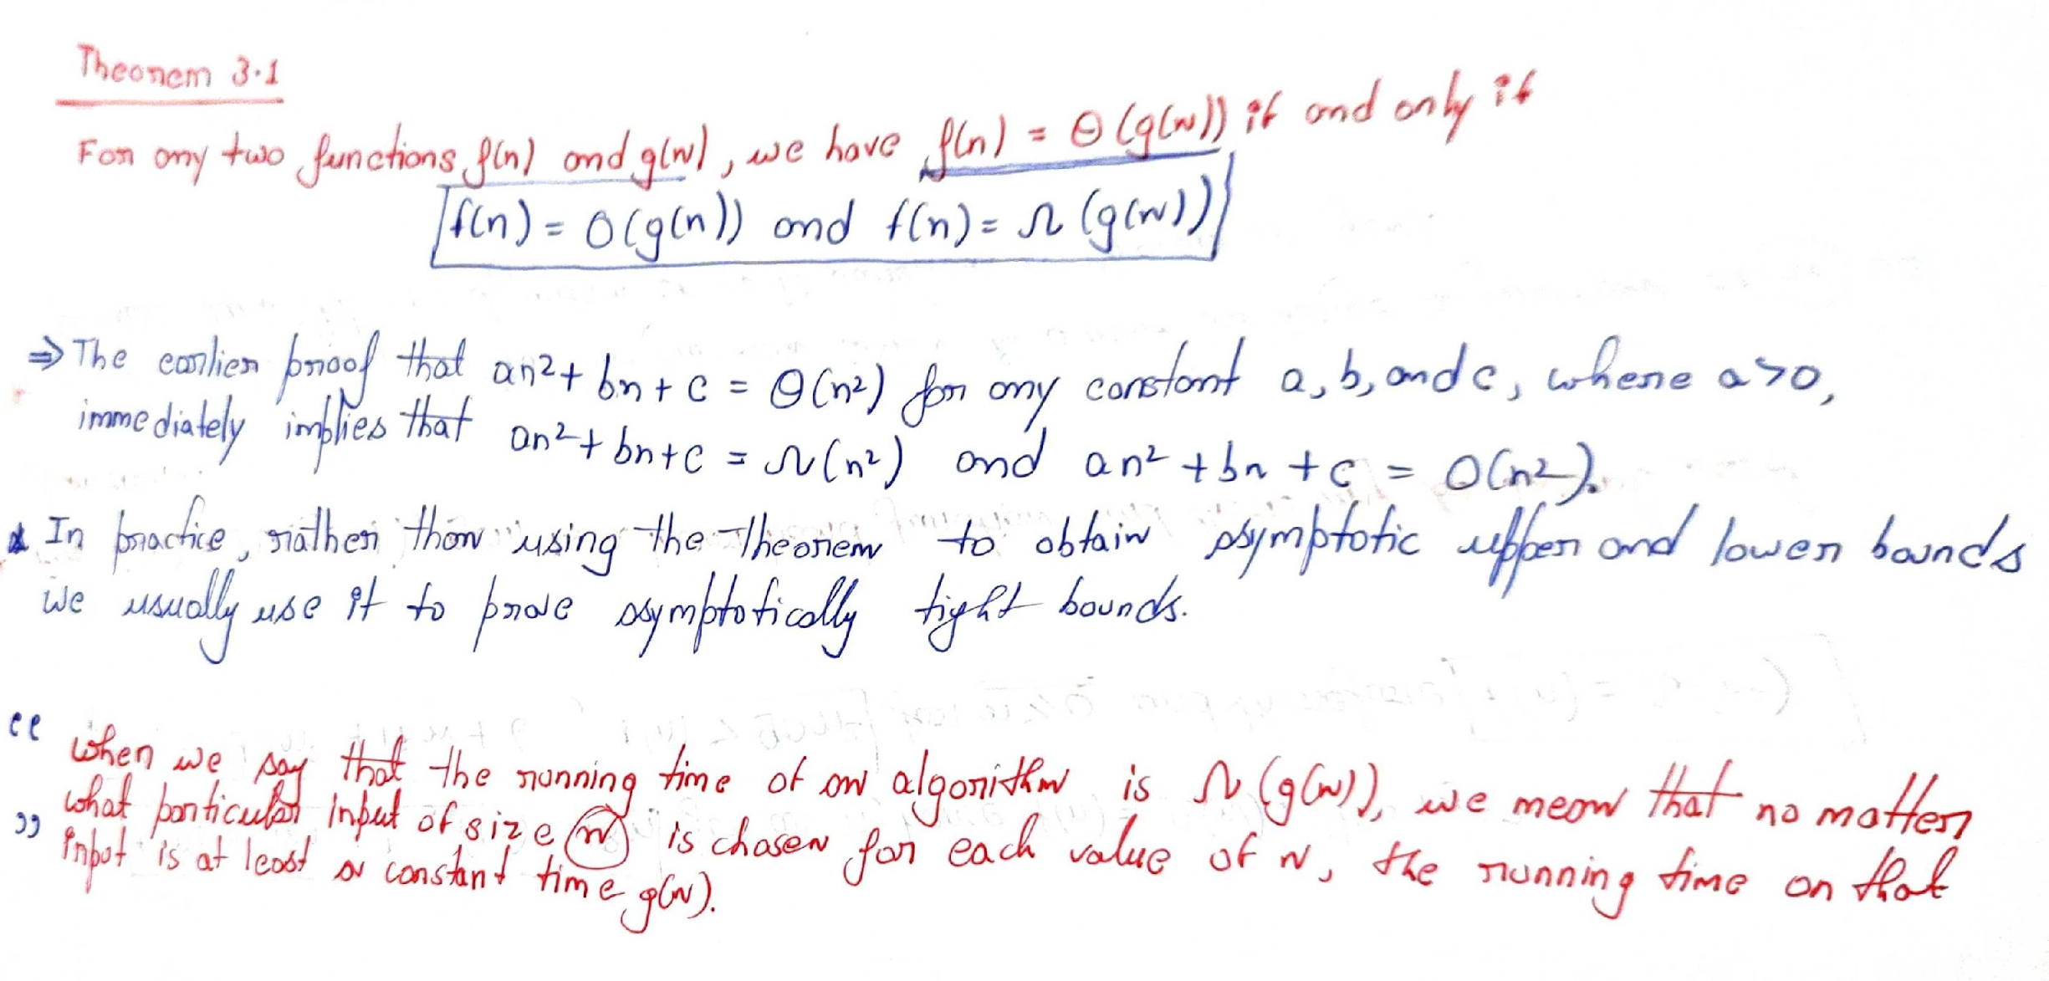
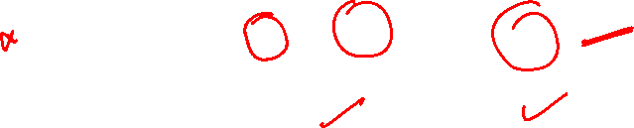
Poof will cover afterwards

Slide 19
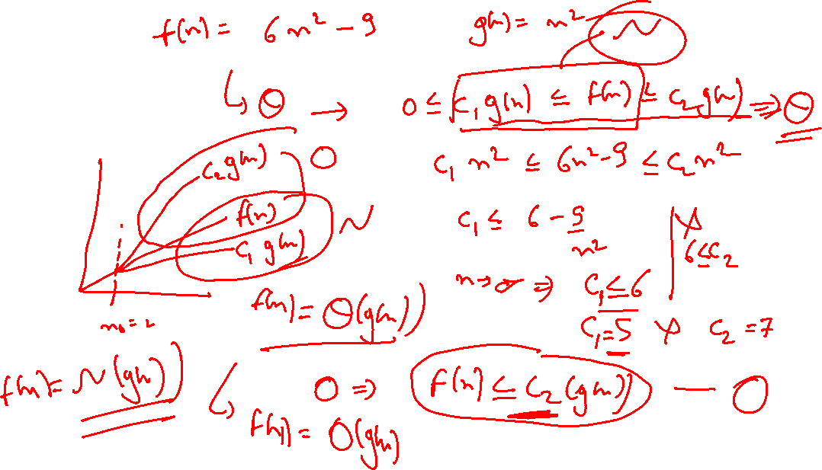

Slide 20
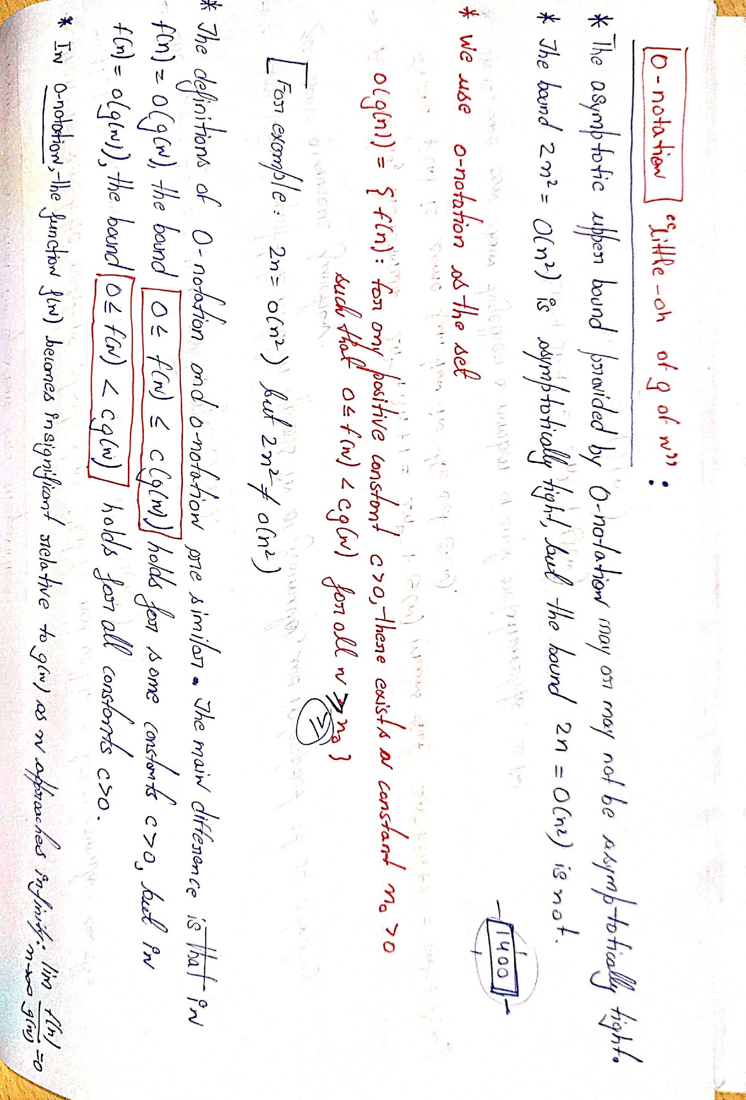
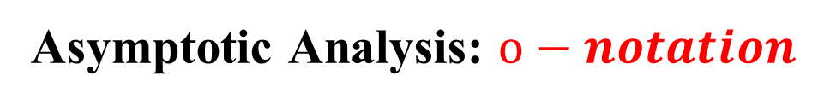
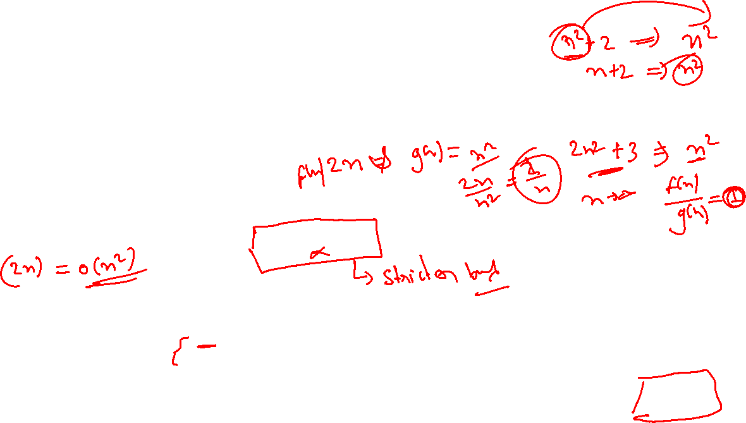
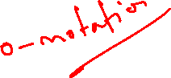

Slide 21
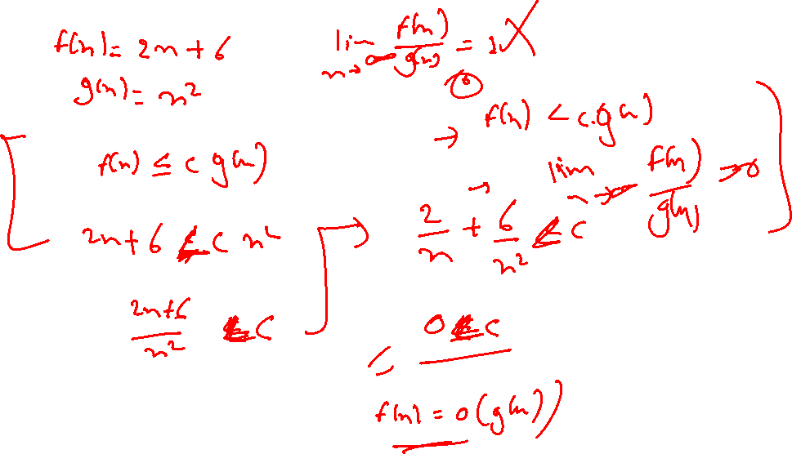

Slide 22
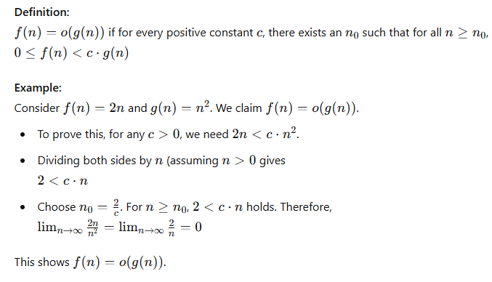
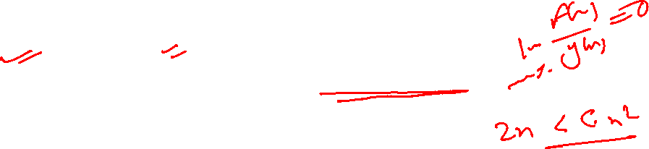

Slide 23
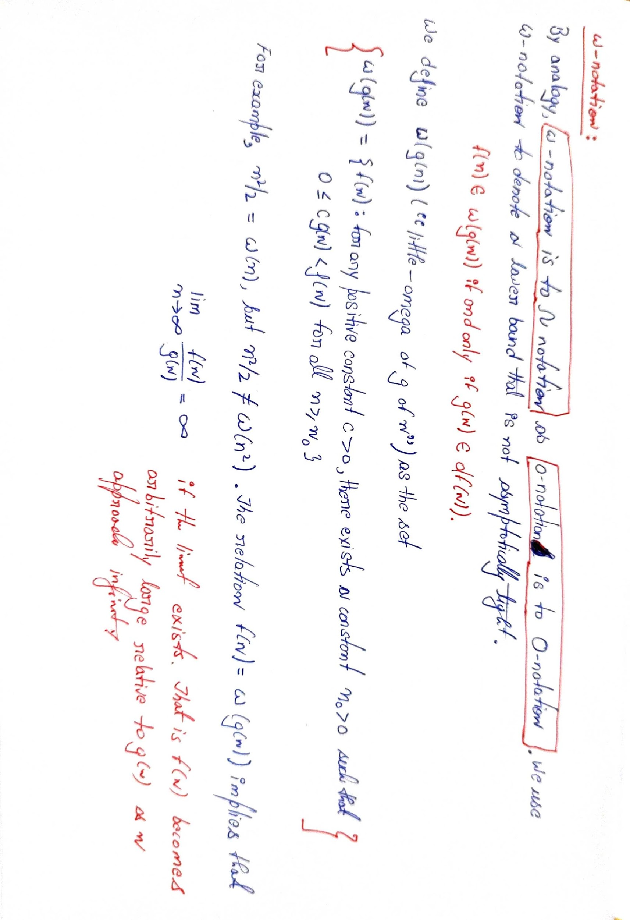
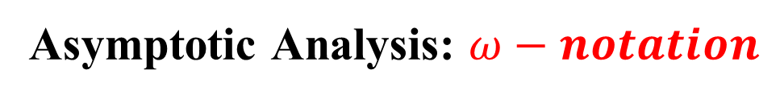
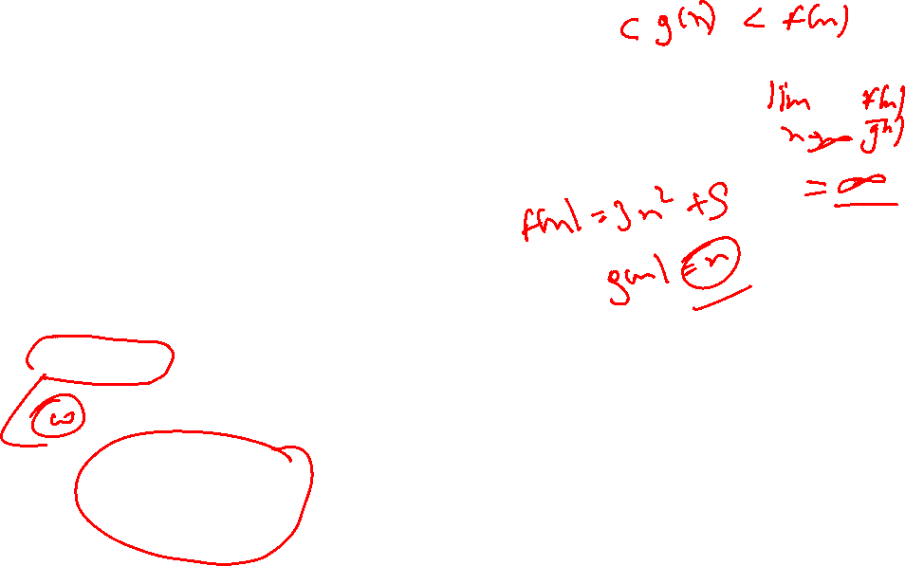

Slide 24
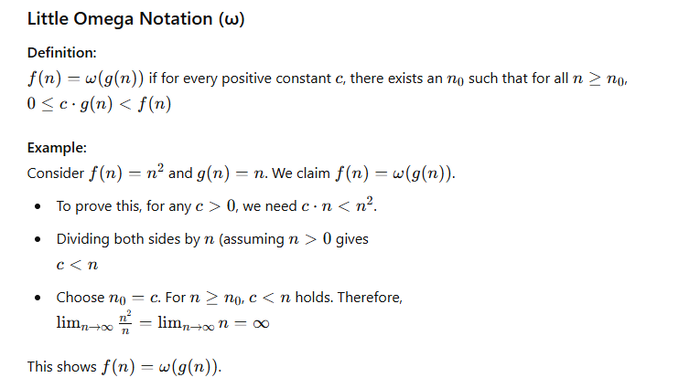
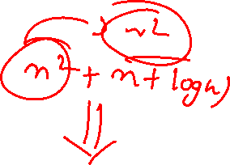

Slide 25
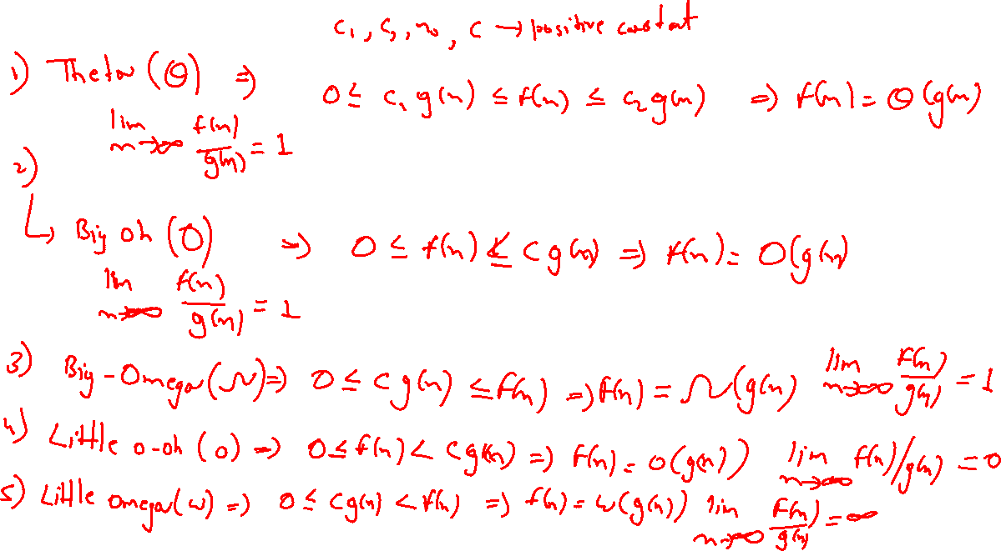

Slide 26
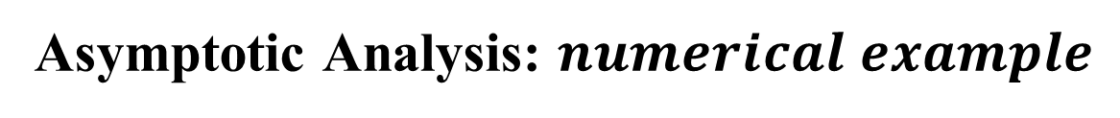
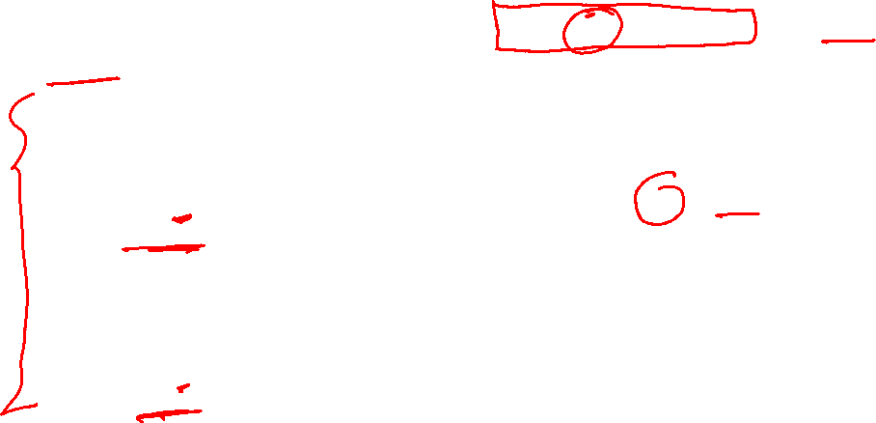
Big O notation: Consider the function f(n) = n^3 + 2n^2 + 5. The big O notation for f(n) is O(n^3) because the highest-order term in the polynomial is n^3. As n gets larger, the contribution of the other terms becomes relatively insignificant compared to the dominant n^3 term.
Big Omega notation: Consider the function f(n) = n^2 + 10n. The big Omega notation for f(n) is Ω(n^2) because the lowest order term in the polynomial is n^2. As n gets larger, the contribution of the other term (10n) becomes relatively insignificant compared to the dominant n^2 term.
Big Theta notation: Consider the function f(n) = 3n^2 + 4n + 2. The big Theta notation for f(n) is Θ(n^2) because the highest and lowest order terms in the polynomial are n^2. As n gets larger, the contribution of the other term (4n + 2) becomes relatively insignificant compared to the dominant n^2 term.

Slide 27



4. Little o notation: Consider the function f(n) = n^2 + 2log(n). The little O notation for f(n) is o(log n).
5. Little Omega notation:
Consider the function f(n) = n^2 + nlog(n).
The little Omega notation for f(n) is ω(nlogn)

Slide 29


Properties of Asymptotic Notations

Slide 30

Properties of Asymptotic Notations
4. Addition: If f(n) = Θ(h(n)) and g(n) = Θ(k(n)), then f(n) + g(n) = Θ(max(h(n), k(n))). This property allows us to analyze the complexity of an algorithm that involves multiple functions.
5. Multiplication: If f(n) = O(h(n)) and g(n) = O(k(n)), then f(n)g(n) = O(h(n)k(n)). This property allows us to analyze the complexity of an algorithm that involves multiple functions.
6. Transpose: If f(n) is a non-negative monotonic increasing function, then 𝑓(𝑛)=Θ(𝑔(𝑛)), then 𝑓^−1(𝑛)=Θ(𝑔^−1(𝑛)) where f^-1 is the inverse function of f. This property allows us to analyze the complexity of the inverse of a function.
These properties of asymptotic notation allow us to analyze the complexity of algorithms and functions and compare their efficiency in terms of time and space complexity.

Slide 31
Questions on Asymptotic Notations
What is the Big O notation for the function f(n) = 2n^2 + 3n + 1?
What is the Big Omega notation for the function g(n) = 4n + 2log(n)?
If f(n) = 3n^2 + 2nlog(n) and g(n) = 5nlog(n), which function has a higher order of growth as n approaches infinity?
If f(n) = 2^n and g(n) = n!, which function has a higher order of growth as n approaches infinity?
What is the Big Theta notation for the function h(n) = n^3 + 5n^2 + 3n + 1?

Slide 32

Questions and Answers on Asymptotic Notations
What is the Big O notation for the function f(n) = 2n^2 + 3n + 1? Answer: The Big O notation for f(n) is O(n^2) because the highest order term in the polynomial is n^2.
What is the Big Omega notation for the function g(n) = 4n + 2log(n)? Answer: The Big Omega notation for g(n) is Ω(n) because the lowest order term in the polynomial is n.
If f(n) = 3n^2 + 2nlog(n) and g(n) = 5nlog(n), which function has a higher order of growth as n approaches infinity? Answer: To compare the growth rate of the two functions, we need to compare their dominant terms. The dominant term of f(n) is n^2 and the dominant term of g(n) is nlog(n). Therefore, as n approaches infinity, f(n) has a higher order of growth than g(n).

Slide 33

Questions and Answers on Asymptotic Notations
4. If f(n) = 2^n and g(n) = n!, which function has a higher order of growth as n approaches infinity? Answer: To compare the growth rate of the two functions, we need to compare their dominant terms. The dominant term of f(n) is 2^n and the dominant term of g(n) is n^n. Therefore, as n approaches infinity, g(n) has a higher order of growth than f(n).
5. What is the Big Theta notation for the function h(n) = n^3 + 5n^2 + 3n + 1? Answer: The Big Theta notation for h(n) is Θ(n^3) because both the highest and lowest order terms in the polynomial are n^3.

Slide 34
Summary
Asymptotic notation is a significant idea in computer science and algorithm analysis because it gives a mechanism to evaluate and compare the efficiency of algorithms in a way that is independent of the exact hardware or software platform on which they are implemented. The following considerations clarify the significance of the asymptotic notation:
Platform independence
Simplicity and abstraction
Algorithm selection
Predicting scalability

Slide 35
Summary
Let us describe the mechanism of using asymptotic notation:
Analyzing time complexity
Understanding space complexity
Comparing algorithms
Identifying dominant terms

Slide 36
Summary
There are several commonly used asymptotic notations, including:
Big O notation (O)
Omega notation (𝛺)
Theta notation (𝛩)
Little o notation (o): This indicates a non-asymptotically tight upper bound. It describes functions that grow strictly faster than a given function.
Little omega notation (): This denotes a non-asymptotically tight lower bound. It describes functions that grow strictly slower than a given function.

Slide 37


Divide-and-Conquer
Divide and Conquer is more than just a military strategy; it is also a method of algorithm design that has created such efficient algorithms as Merge Sort.
In terms of algorithms, this method has three distinct steps:
Divide: If the input size is too large to deal with straightforwardly, divide the data into two or more disjoint subsets.
Conquer: Use divide and conquer to solve the sub-problems associated with the data subsets.
Combine: Take the solutions to the sub-problems and “merge” these solutions into a solution for the original problem.

Slide 38



Slide 39


Merge sort
Merge Sort is a divide-and-conquer algorithm (divide and conquer will be detailed later) that efficiently sorts an array or a list by recursively dividing it into smaller sub-problems, sorting those sub-problems, and then merging the results. Merge Sort has a time complexity of O(n log n) in the worst, average, and best cases, (we will see this) making it a stable and consistent sorting algorithm. The steps of the Merge sort algorithm are defined as follows:
Divide: Divide the unsorted list into n sublists, each containing one element. This is the base case of the recursion.
Conquer: Recursively sort each sub-list.
Combine (Merge): Merge the sorted sublists back together to produce a single sorted list.
The algorithm starts by dividing the unsorted list into n sublists, each with one element. This is the base case, and the recursion stops when each sub-list contains one element. The algorithm recursively sorts each sub-list.
The recursion continues until all sublists are sorted. The divide-and-conquer strategy ensures that sorting smaller sublists is simpler and more efficient.
The final step involves merging the sorted sublists to create a single sorted list.
This is achieved by repeatedly comparing the smallest unprocessed element from each sub-list and selecting the smaller. The selected element is then added to the merged list.
This process continues until all elements from the sublists are merged into the final sorted list.

Slide 40


Slide 41


Merge sort
The advantages of the Merge sort are as follows:
Stable Sorting: Merge Sort is a stable sorting algorithm, meaning that it maintains the relative order of equal elements in the sorted output.
Predictable Performance: Its time complexity is consistently O(n log n) in the worst, average, and best cases.
Adaptability: Merge Sort is well-suited for linked lists and external sorting where random access is expensive.
The primary drawbacks of their merge sort are as follows:
Space Complexity: Merge Sort typically requires additional space for merging, making it less memory-efficient compared to in-place algorithms.
Not In-Place: It is not an in-place sorting algorithm, which means it may not be suitable for scenarios with limited memory.

Slide 42

Merge-Sort
Algorithm:
Divide: If S has at least two elements (nothing needs to be done if S has zero or one element), remove all the elements from S and put them into two sequences, S₁ and S₂, each containing about half of the elements of S. (i.e. S₁ contains the first ⎡n/2⎤ elements and S₂ contains the remaining ⎣n/2⎦ elements.
Conquer Recursive sort sequences S₁ and S₂.
Combine: Put back the elements into S by merging the sorted sequences S₁ and S₂ into a unique sorted sequence.

Slide 43


Merge-Sort

Slide 44

Merge-Sort(cont.)

Slide 45
Merge-Sort (cont.)

Slide 46
Merge-Sort (cont.)

Slide 47
Merge-Sort (cont.)

Slide 48

Merge-Sort (cont.)

Slide 49
Merge-Sort (cont.)

Slide 50

Merge-Sort(cont.)

Slide 51

Merge-Sort (cont.)

Slide 52
Merge-Sort (cont.)

Slide 53

Merge-Sort (cont.)

Slide 54
Merging Two Sequences

Slide 55



Merging Two Sequences (cont.)

Slide 56
Merging Two Sequences (cont.)

Slide 57
Merging Two Sequences (cont.)

Slide 58
Merging Two Sequences (cont.)

Slide 59
Merging Two Sequences (cont.)

Slide 61



Merge sort

Slide 62


Merge sort
#Procedure for Merge
Merge(left, right):
result = []
left_index = right_index = 0
while left_index < length(left) and right_index < length(right):
if left[left_index] < right[right_index]:
result.append(left[left_index])
left_index += 1
else:
result.append(right[right_index])
right_index += 1
result.extend(left[left_index:])
result.extend(right[right_index:])
return result
#Procedure for MergeSort
MergeSort(arr):
if length(arr) <= 1:
return arr
middle = length(arr) / 2
left_half = MergeSort(arr[:middle])
right_half = MergeSort(arr[middle:])
return Merge(left_half, right_half)

Slide 63




